Slide 1

Crop adaptation and mitigation to drought
Delivered by
Mr. Anil Swami
Asst. Professor
Rainfed Agriculture & Watershed Management Mr. Anil Swami

Slide 2
Objective:-
Tell the soil and climatic conditions prevalent in rainfed areas.
Interpret various water harvesting techniques and their efficient utilization.
Apply contingent crop planning for aberrant weather conditions.
Examine the seasonal rainfall and different types of watershed and its components.
Select soil and water conservation techniques to avoid their losses.

Slide 3
Crop Adaptations
The ability of crop to grow satisfactorily under water stress is called drought adaptation. Adaptation is structural or functional modification in plants to survive and reproduce in a particular environment.
Crops survive and grow under moisture stress conditions mainly by two ways:
Escaping drought and
Drought resistance

Slide 4
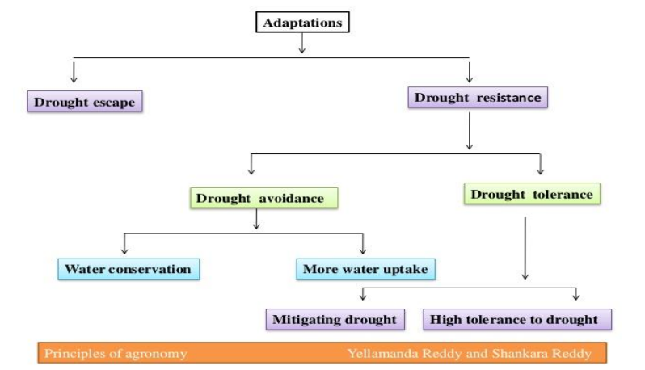
Flow chart showing different mechanisms for overcoming moisture stress

Slide 5
Escaping Drought
Evading the period of drought is the simplest means of adaptation of plants to dry conditions. Many short duration desert plants, (ephemerals), germinate with rains and mature in five to six weeks. These plants have no mechanism for overcoming moisture stress and are, therefore, are not drought resistant.

Slide 6
In cultivated crops, the ability of a cultivar to mature before the soil dries is the main adaptation to growth in dry regions.
However, only very few crops have such a short growing season to be called as ephemerals.
Certain varieties of pearl millet mature within 60 days after sowing.
Short duration pulses like cowpea, green-gram, black gram can be included in this category.
In addition to earliness, they need drought resistance because there may be dry spells within the crop period of 60 days.
The disadvantage about breeding early varieties is that yield is reduced with reduction in duration.

Slide 7
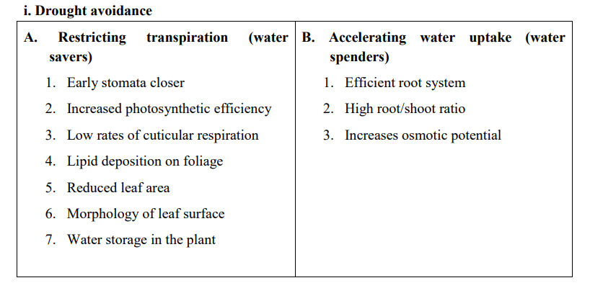
Drought Resistance
Plants can adopt to drought either by avoiding stress or by tolerating stress due to different mechanisms. These mechanisms provide drought resistance.

Slide 8
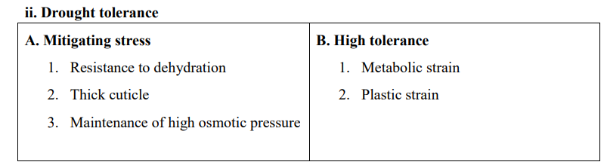

Slide 9
Avoiding Stress
Stress avoidance is the ability to maintain a favourable water balance, and turgidity even when exposed to drought conditions, there by avoiding stress and its consequences.
A favourable water balance under drought conditions can be achieved either by:
Conserving water by restricting transpiration before or as soon as stress is experienced; or
Accelerating water uptake sufficiently so as to replenish the lost water.

Slide 10
Strategies for drought management
The different strategies for drought management are discussed under the following heads.
Adjusting the plant population:
The plant population should be lesser in dryland conditions than under irrigated conditions. The rectangular type of planting pattern should always be followed under dryland conditions. Under dryland conditions whenever moisture stress occurs due to prolonged dry spells, under limited moisture supply the adjustment of plant population can be done by low plant population.

Slide 11
a) Increasing the inter row distance: By adjusting a greater number of plants within the row and increasing the distance between the rows reduces the competition during any part of the growing period of the crop. Hence it is more suitable for limited moisture supply conditions.
b) Increasing the intra row distance: Here the distance between plants is increased by which plants grow luxuriantly from the beginning. There will be competition for moisture during the reproductive period of the crop. Hence it is less advantageous as compared to above under limited moisture supply.

Slide 12
2. Mid-season corrections:
The contingent management practices done in the standing crop to overcome the unfavourable soil moisture conditions due to prolonged dry spells are known as mid-season conditions.
a) Thinning: This can be done by removing every alternate row or every third row which will save the crop from failure by reducing the competition
b) Spraying: In crops like groundnut, castor, red gram, etc., during prolonged dry spells the crop can saved by spraying water at weekly intervals or 2 per cent urea at week to 10 days interval.
c) Ratooning: In crops like sorghum and bajra, ratooning can practice as mid-season correction measure after break of dry spell.

Slide 13
Mulching:
It is a practice of spreading any covering material on soil surface to reduce evaporation losses. The mulches will prolong the moisture availability in the soil and save the crop during drought conditions.
Weed control:
Weeds compete with crop for different growth resources ore seriously under dryland conditions. The water requirement of most of the weeds is more than the crop plants. Hence, they compete more for soil moisture. Therefore, the weed control especially during early stages of crop growth reduces the impact of dry spell by soil moisture conservation.

Slide 14
Water harvesting and lifesaving irrigation:
The collection of runoff water during peak periods of rainfall and storing in different structures is known as water harvesting. The stored water can be used for giving the lifesaving irrigation during prolonged dry spells.

Slide 15
Thank You
Rainfed Agriculture & Watershed Management Mr. Anil Swami

